Slide 1

Micro- en nanotechnology
Part 2 by Jessica de Wild (Jessica.deWild@uhasselt.be)

Slide 2
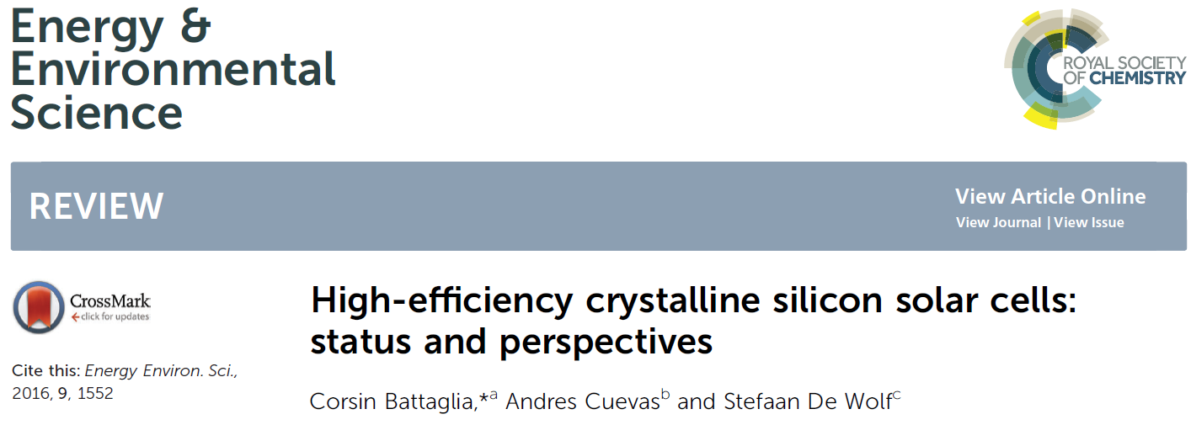
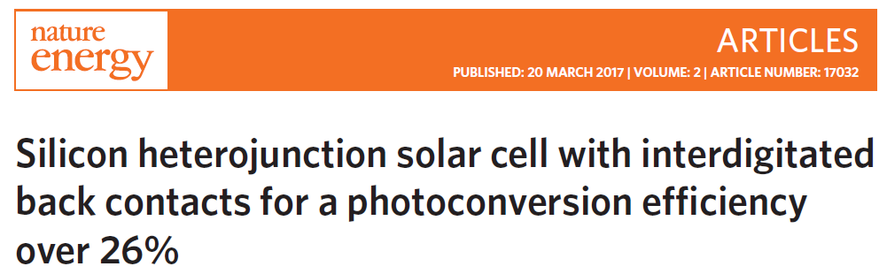

Solar cells
Papers
Notes:
I will start explaining what is ment with photoconversion efficiency and basic solar cells equations. Secondly, i will introduce the silicon solar cell world. The different techniques, and within that the interdigitated back contacts will be explained

Slide 3
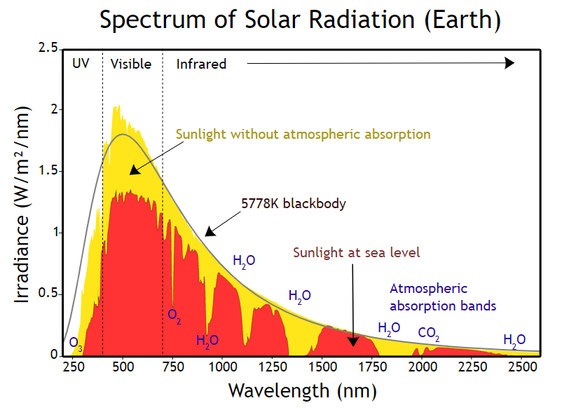
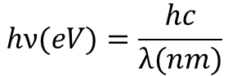
Solar energy
Solar Irradiance: power per unit area received from the sun
Photon energy:
$$hν(eV)=\frac{hc}{λ(nm)}$$
Total energy per m² on earth: 1000 W/m²

Slide 4
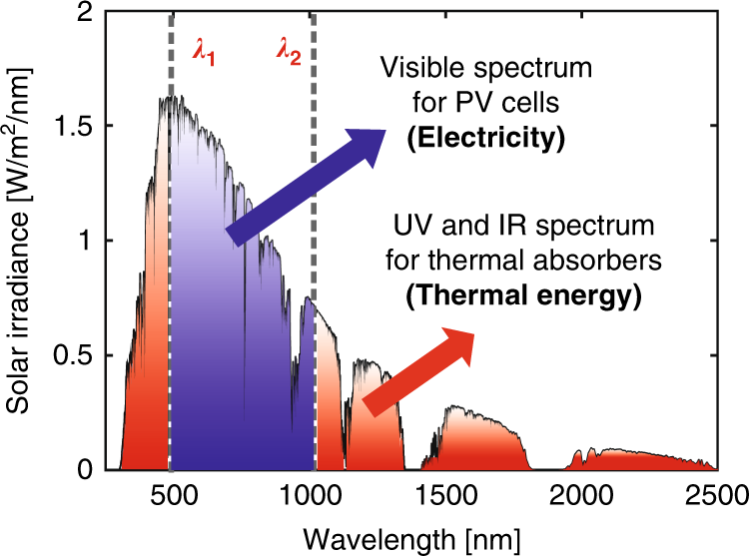
Solar cells
Solar cells convert power from the sun (electromagnetic waves or ‘light’) into electrical power
Only light with photon energy higher than the band gap of the material is absorbed
https://en.wikipedia.org/wiki/Solar_cell

Slide 5
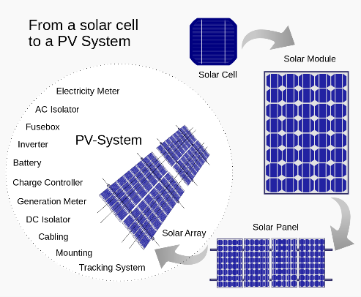
Solar cells
Power output depends on the area:
Irradiance = 1000 W/m² → 26% efficient solar cells delivers 260 W/m²
Nominal performance: W_{p} (Watt-peak)
Solar panel of 1.6 m² delivers 350 Wp
10 panels on the roof → 3.5 kWp
Area of solar panels : 16 m²
https://en.wikipedia.org/wiki/Solar_cell

Slide 6
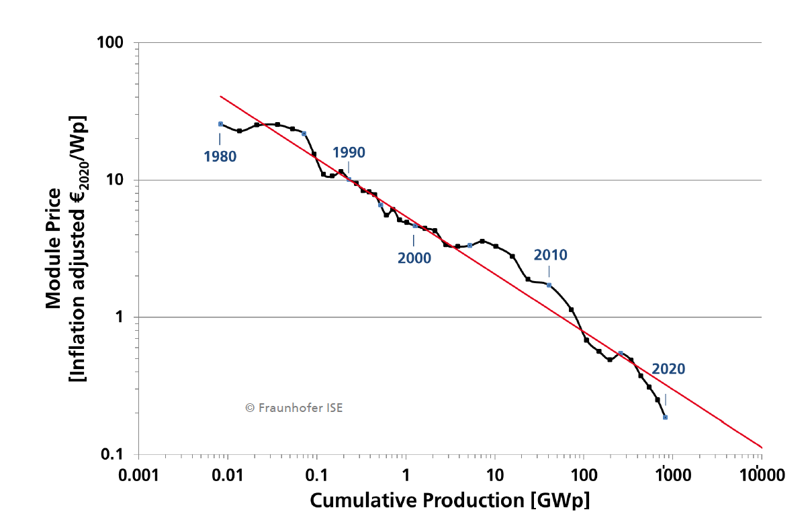
Solar market
Learning rate: every doubling in PV module production reduces the price by 25%
https://www.ise.fraunhofer.de/content/dam/ise/de/documents/publications/studies/Photovoltaics-Report.pdf

Slide 7
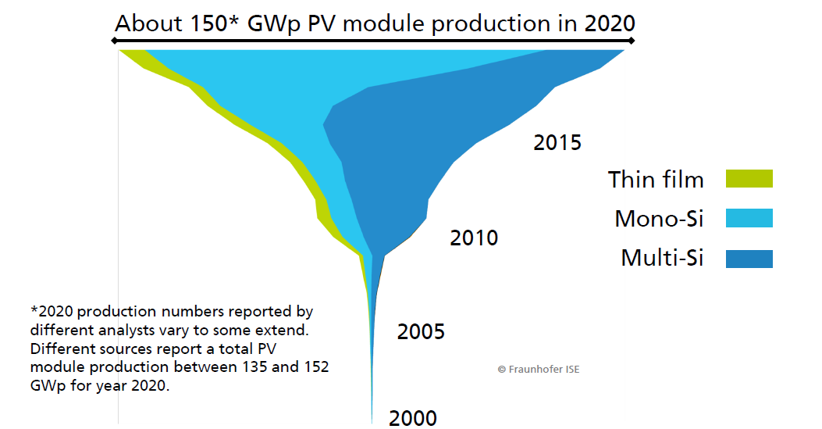
Solar cells
PV production
https://www.ise.fraunhofer.de/content/dam/ise/de/documents/publications/studies/Photovoltaics-Report.pdf

Slide 8
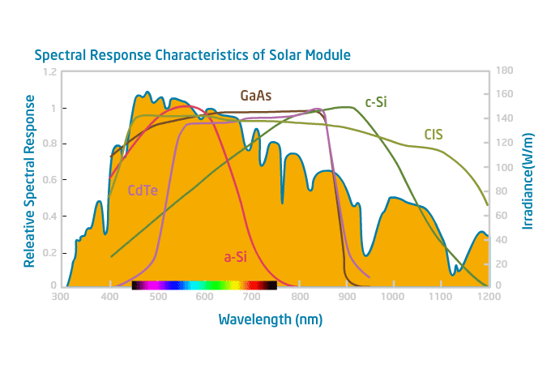
Photovoltaic materials
Different commercial technologies
-Si wafer technology (mono and multi-crystalline)
-thin film technology (a-Si, Cu(In,Ga)Se₂, CdTe)
Emerging technology
-perovskite
Photon energy:
$$hν(eV)=\frac{hc}{λ(nm)}$$
Various properties, applications, fabrication methods, costs etc

Slide 9


Photovoltaic materials
Conduction band
Conduction band
Conduction band
Energy (eV)
$$γ_{eV}$$
Valence band
Valence band
Valence band
Insulator
Semiconductor
Conductor
$$γ_{eV}$$
is in the range of the photon energy coming from the sun

Slide 10
Photovoltaic materials
After absorption of a photon a valence electron in the valence band is excited to the conduction band
Electrons in the conduction band are free electrons and conduct electricity
Electron leave a ‘hole’ behind in the valence band (a ‘hole’ is a place were there used to be an electron)
The amount of holes / electrons determined the doping of a semiconductor
Conduction band
Energy (eV)
$$γ_{eV}$$
Valence band
Semiconductor

Slide 11
Doping
Intrinsic, p or n type doping
When photon is absorbed, a hole (h) is left behind in the valence band and electron (e) is added in the conduction band → # of e = # of h
Doping can increase the concentration of 1 type of carrier
Dopant adding electrons → n-type semi-conductor, dopant adding holes → p-type semi-conductor
Conduction band
$$γ_{eV}$$
Valence band

Slide 12
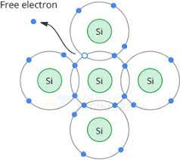
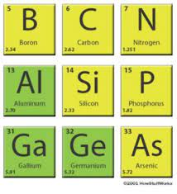
Doping
Intrinsic, p or n type doping
When photon is absorbed, a hole (h) is left behind in the valence band and electron (e) is added in the conduction band → # of e = # of h
Doping can increase the concentration of 1 type of carrier
Dopant adding electrons → n-type semi-conductor, dopant adding holes → p-type semi-conductor
Conduction band
$$γ_{eV}$$
Valence band
3e⁻ 4e⁻ 5e⁻
p-type n-type
Doping increases the concentration several orders of magnitude
~10¹⁰ → 10¹³ - 10¹⁸

Slide 13
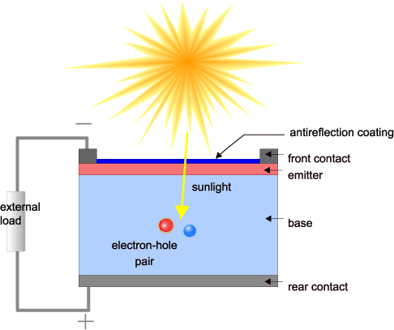
Solar cells
Basic working principle:
1) the generation of light-generated carriers;
2) the collection of the light-generated carries to generate a current
3) the generation of a large voltage across the solar cell
4) the dissipation of power in the load and in parasitic resistances
Emitter: n-type (phosphor)
→ high concentration electrons
Base: p-type (boron)
→ high concentration holes
https://www.pveducation.org/pvcdrom/solar-cell-operation/solar-cell-structure

Slide 14
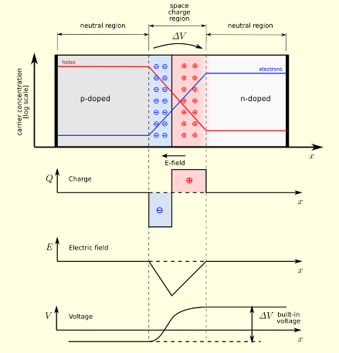
Solar cells
Basic working principle:
P region: high concentration of holes
N region: high concentration of electrons
Where n and p type regions are in contact:
Creation on pn junction
Electric field → carrier flow
p–n junction - Wikipedia
IV Curve | PVEducation

Slide 15
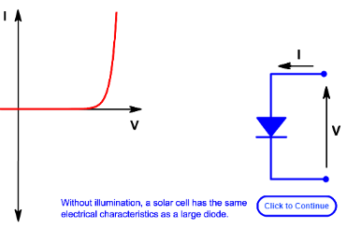
Solar cells
Basic working principle:
1) Creation of diode, current flows in one directions
p–n junction - Wikipedia
IV Curve | PVEducation

Slide 16
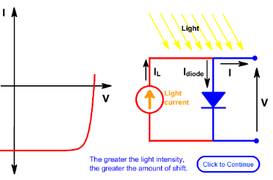
Solar cells
Basic working principle:
Light generated carriers increased the current flow and power is generated
P = I*V
p–n junction - Wikipedia
IV Curve | PVEducation

Slide 17
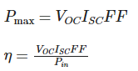
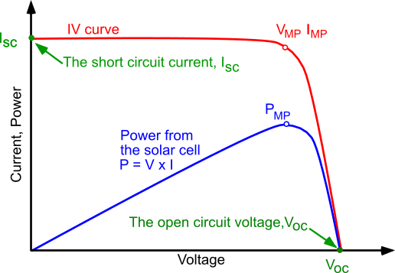
Solar cells
IV curve
The efficiency of a solar cell is determined as the fraction of incident power which is converted to electricity and is defined as:
Where: V_{oc} is the open-circuit voltage; I_{sc} is the short-circuit current; FF is the fill factor and η is the efficiency
https://www.pveducation.org/pvcdrom/solar-cell-operation/solar-cell-structure

Slide 18
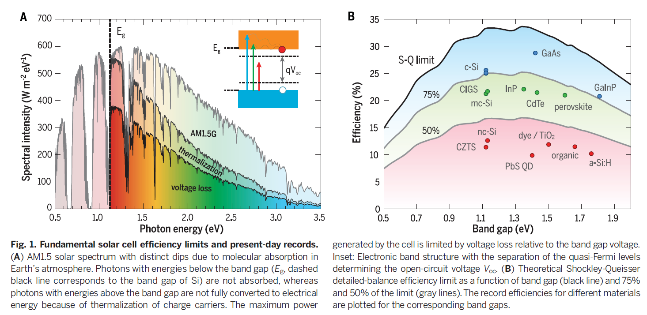
Photovoltaic materials
Schockley Queisser Limit
Photovoltaic materials: Present efficiencies and future challenges DOI: 10.1126/science.aad4424
Notes:
Thermal equilibrium

Slide 19
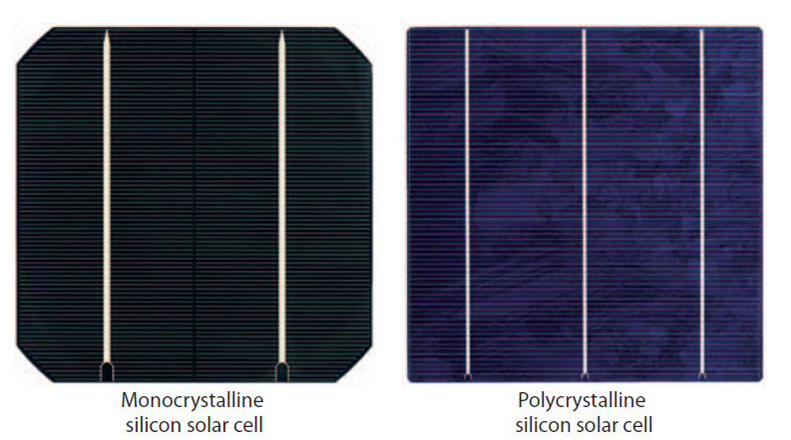
Si technology
Basic silicon solar cell

Slide 20
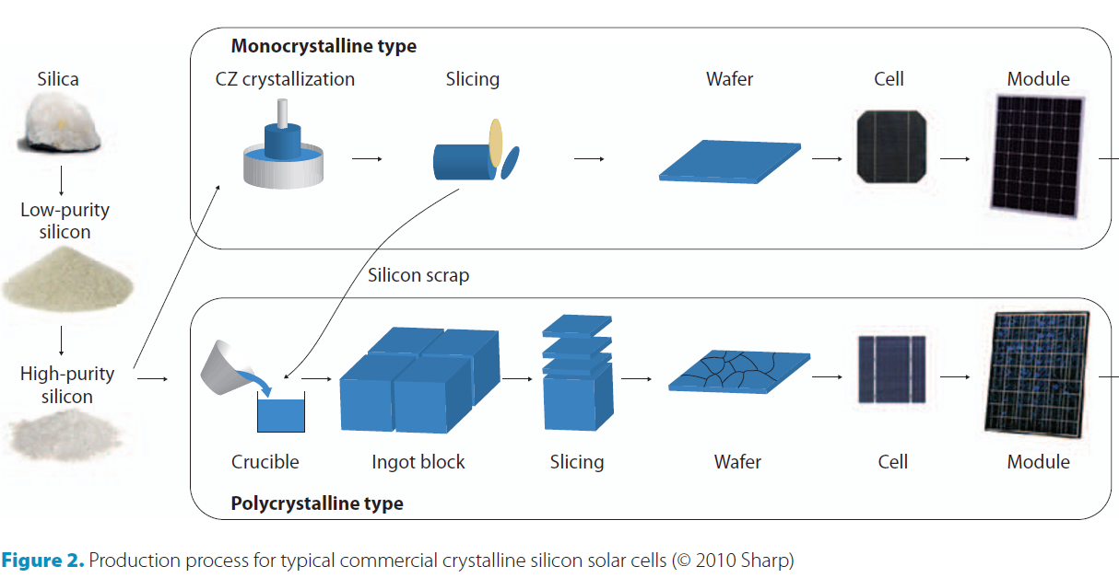
Si technology
Processing

Slide 21
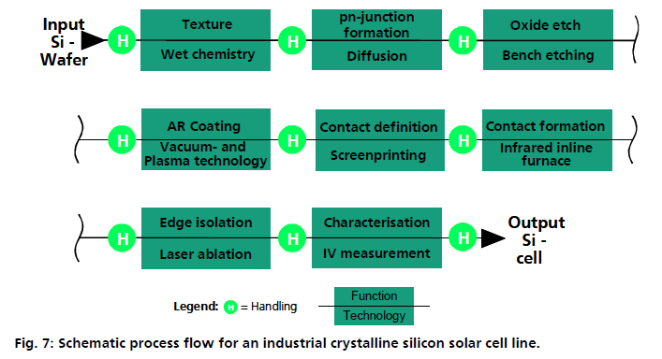
Si technology

Slide 22
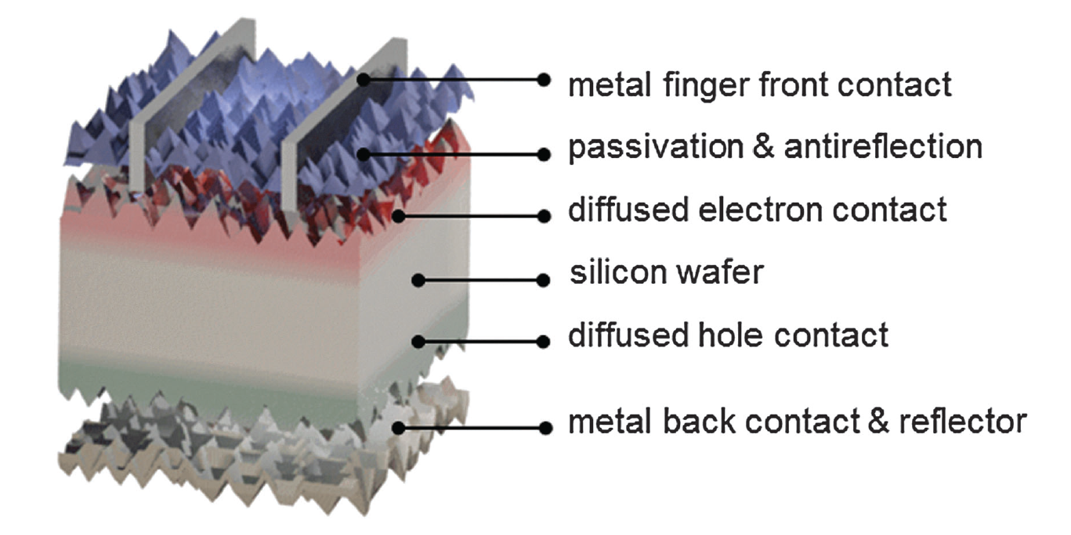
Si technology
Basic silicon solar cell
Silicon wafer: light absorbing material
~ 150 -200 µm
High-efficiency crystalline silicon solar cells: status and perspectives DOI: 10.1039/c5ee03380b

Slide 23
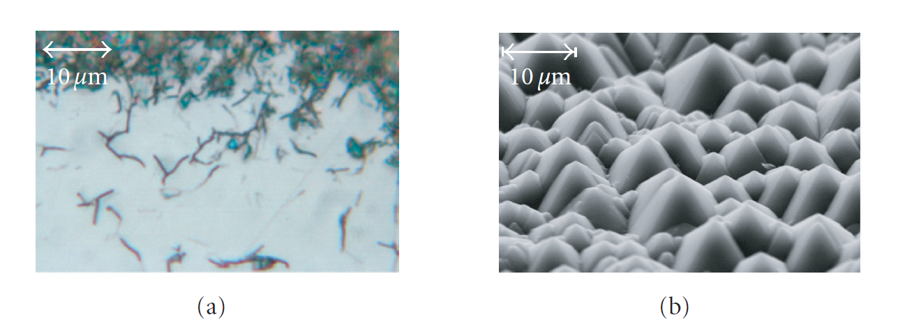
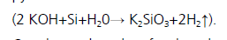
Si technology
Wafer cleaning after cutting
Removal of sawing damage using KOH
Formation of pyramids during cleaning
Light scattering properties
Notes:
Potasium silicate and hydrogen

Slide 24
Si technology
Formation of pn junction
Phosphor diffusion (n-type dopant) on p-type Si wafer
Boron diffusion (p-type dopant) on n-type Si wafer
High-efficiency crystalline silicon solar cells: status and perspectives DOI: 10.1039/c5ee03380b

Slide 25
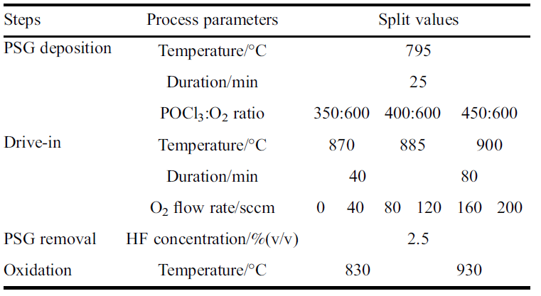
Si technology
Diffusion electron contact (phosphor diffusion)
deposition of PSG
high temperature anneal → P diffusion
removal of PSG
PSG = Phosphosilicate glass (PSG)
POCl3 diffusion for industrial Si solar cell emitter formation Front. Energy 2017, 11(1): 42–51
Notes:
Oxidation to passivate the surface

Slide 26
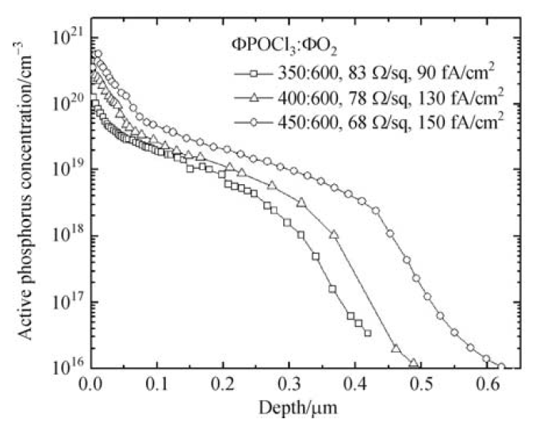
Si technology
Diffusion electron contact
n
p
Depth
High thermal budget!
POCl3 diffusion for industrial Si solar cell emitter formation Front. Energy 2017, 11(1): 42–51

Slide 27
Si technology
Front surface passivation
Surfaces are areas where charges recombine due to dangling bonds → making these inactive or reducing = surface passivation
High-efficiency crystalline silicon solar cells: status and perspectives DOI: 10.1039/c5ee03380b

Slide 28
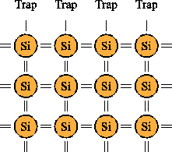
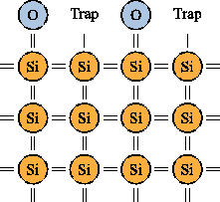
Si technology
Passivation and anti-reflection: SiN_{x} (SiO_{x})
SiN_{x} passivated the dangling bonds (is a di-electric)
https://www.iue.tuwien.ac.at/phd/entner/node14.html

Slide 29
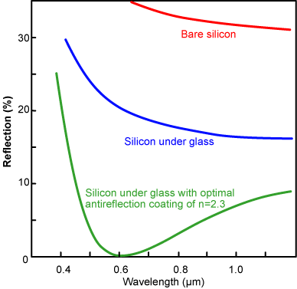
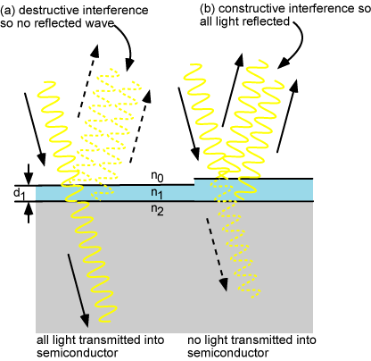
Si technology
Passivation and anti-reflection: SiN_{x}
SiN_{x} passivated the dangling bonds (is a di-electric)
Serves as anti-reflection layer when correct thickness is applied
Optimal thickness ~ 70 nm
https://www.pveducation.org/pvcdrom/design-of-silicon-cells/anti-reflection-coatings

Slide 30
Si technology
Metal contacts to extract the carriers
Metals are not transparent
At the front: optical and electrical optimization by width and height
High-efficiency crystalline silicon solar cells: status and perspectives DOI: 10.1039/c5ee03380b

Slide 31
Si technology
Back contact: metallic layer and p++ doping
High-efficiency crystalline silicon solar cells: status and perspectives DOI: 10.1039/c5ee03380b

Slide 32
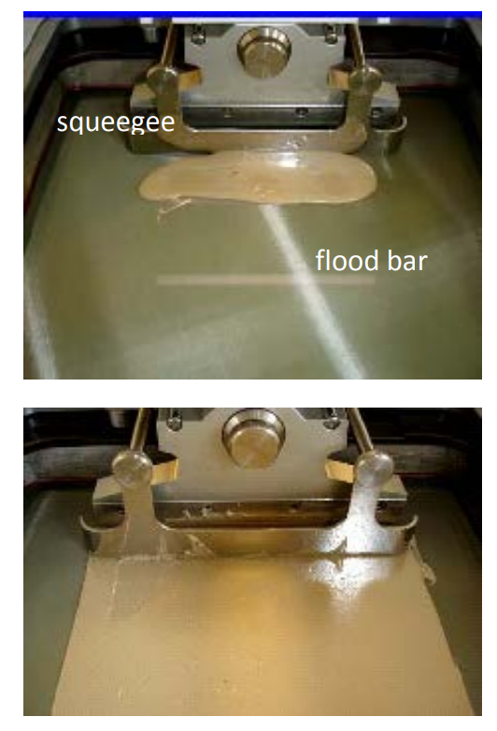
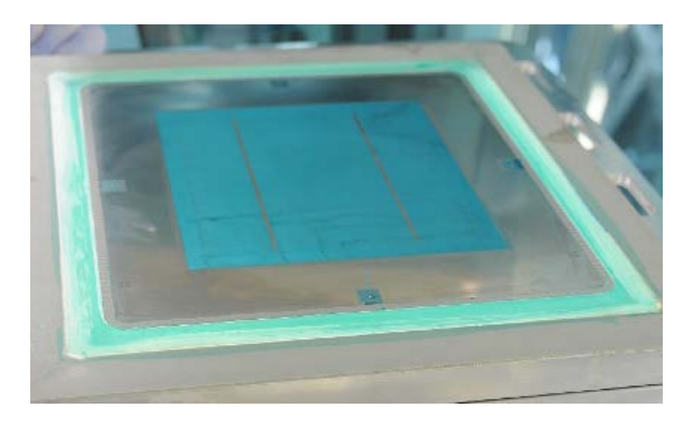
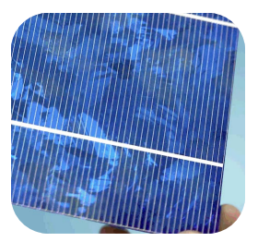
Si technology
Metallization: screen printing
https://www.appliedmaterials.com/files/Screen_Printing_Backgrounder_0.pdf

Slide 33
Si technology
Contact formation front and back metal: firing
Front contact: Ag paste (to contact with the n-type Si)
Back contact: Al paste (also p-type dopant)
Ag paste etches through the SiNx layer
The SiNx layer will crystalize → improving passivation properties
n
p
p++
High thermal budget!

Slide 34
Si technology
Contact formation: firing
Back: Al diffuses into Si layer, making a back surface field (diffused hole contact)
3e⁻ 4e⁻ 5e⁻
p-type n-type

Slide 35
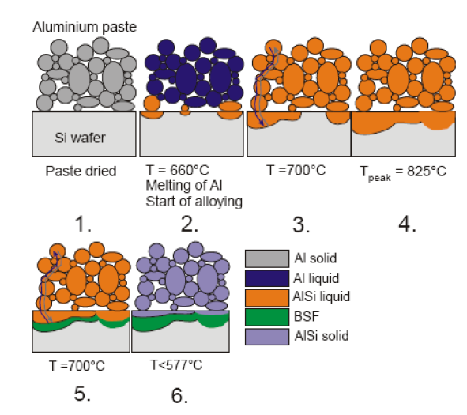
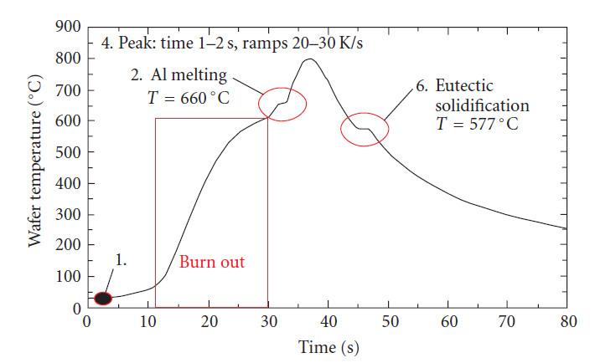
Si technology
Contact formation: firing
Back: Al diffuses into Si layer, making a back surface field (diffused hole contact)

Slide 36
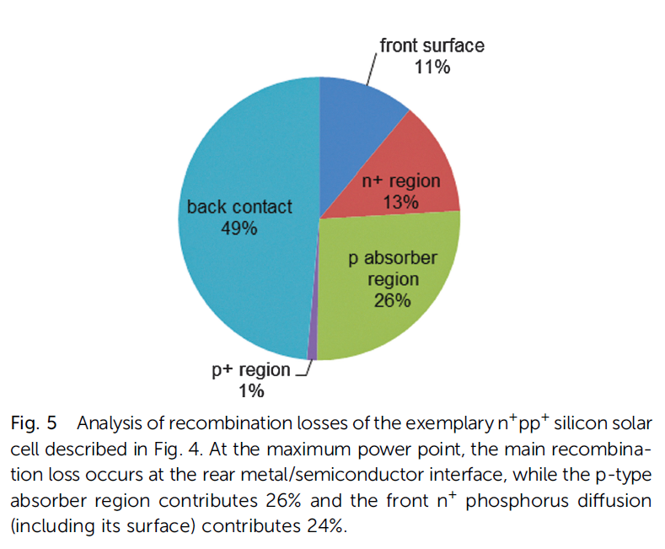
Si technology
Towards high efficiency and low cost:
Reduce optical and electrical losses and reduce thermal budget
High-efficiency crystalline silicon solar cells: status and perspectives DOI: 10.1039/c5ee03380b
https://www.pveducation.org/pvcdrom/design-of-silicon-cells/optical-losses

Slide 37
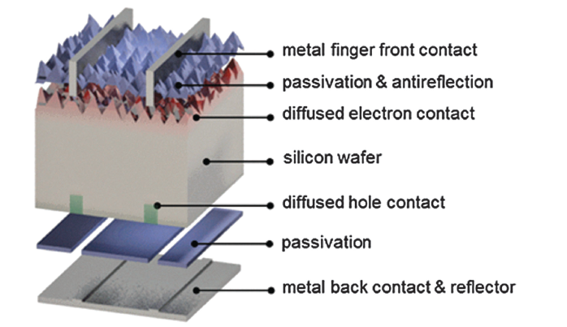
Si technology
Back contact passivation→ di-electric layer to reduce the defect at the Si/metal interface
Contact in the di-electric layer are required for carrier flow → laser ablation
High-efficiency crystalline silicon solar cells: status and perspectives DOI: 10.1039/c5ee03380b

Slide 38
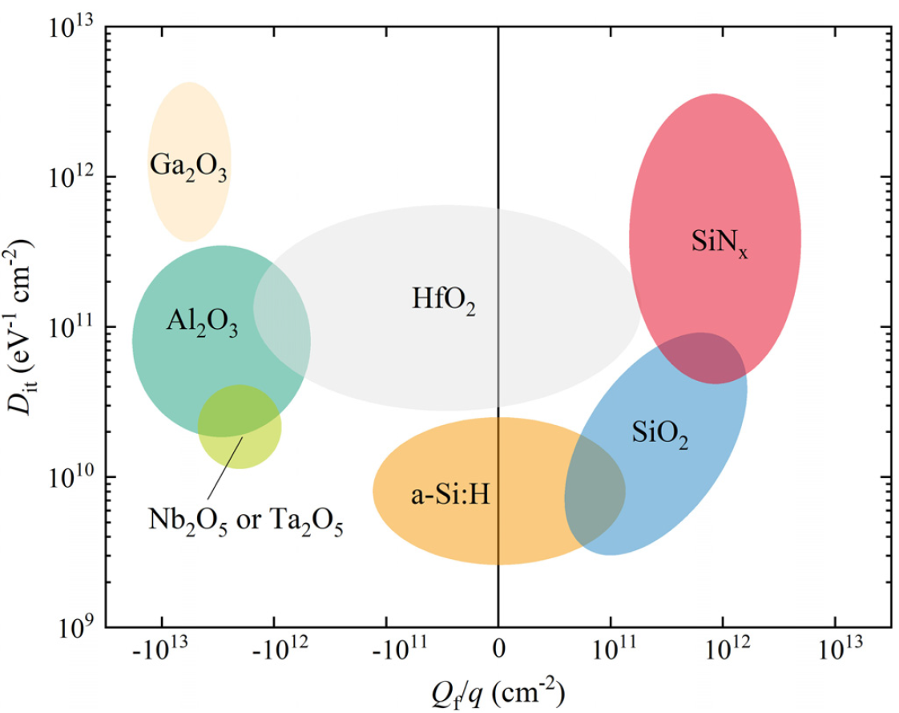
Si technology
Rear contact:
Passivation: low surface recombination velocity on p-type silicon surfaces.
Optics: high internal reflection.
Electrics: compatibility with screen printing and firing processes.
Appl. Phys. Rev. 7, 041315 (2020); https://doi.org/10.1063/5.0005090

Slide 39
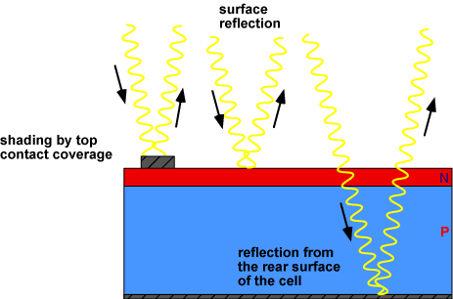
Si technology
Towards high efficiency and low cost:
Reduce optical and electrical losses and reduce thermal budget
Appl. Phys. Rev. 7, 041315 (2020); https://doi.org/10.1063/5.0005090

Slide 40
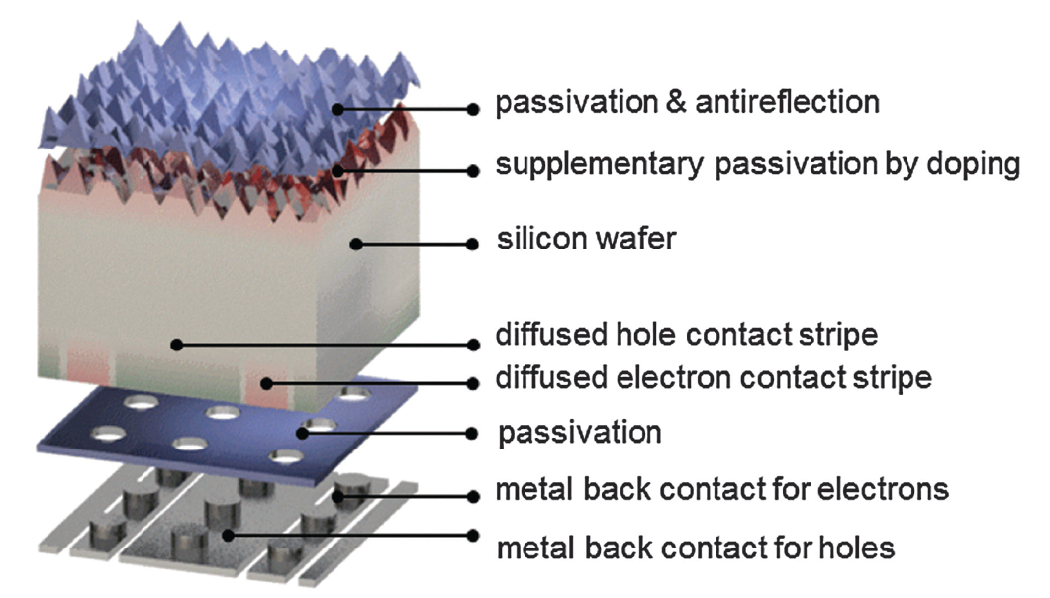
Solar cells
Interdigitated back contact: reduce optical losses due to metallic fingers at the front
Typical distance ~ 10s of micron
High-efficiency crystalline silicon solar cells: status and perspectives DOI: 10.1039/c5ee03380b
Notes:
Hit solar cells: low temperature processing, good passivation

Slide 41
Si technology
Towards high efficiency and low cost:
Reduce optical and electrical losses and reduce thermal budget
Phosphorus diffusion (n-type front contact): ~ 800 ºC
Firing metal contacts (front and back): ~ 800 ºC
Appl. Phys. Rev. 7, 041315 (2020); https://doi.org/10.1063/5.0005090

Slide 42
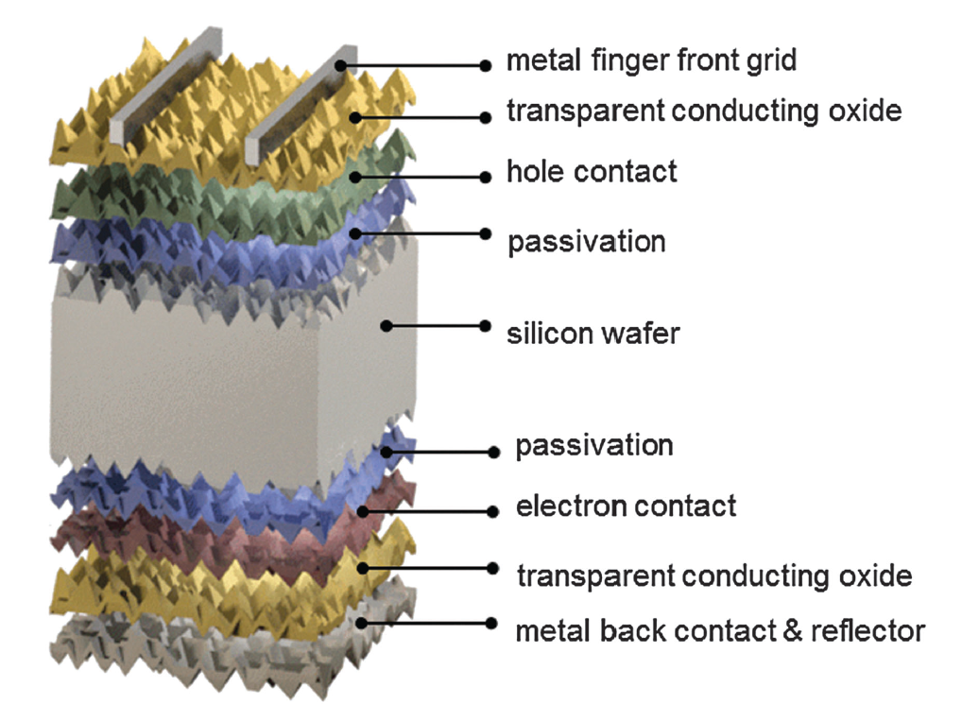
Solar cells
HIT cells: reducing thermal budget
2nd labo (TCO’s)
n-type
High-efficiency crystalline silicon solar cells: status and perspectives DOI: 10.1039/c5ee03380b
Notes:
Hit solar cells: low temperature processing, good passivation

Slide 43
Solar cells
HIT cell: heterojunction with intrinsic thin layer
Amorphous silicon (a-Si)
Crystalline silicon (c-Si)
Amorphous silicon
High-efficiency crystalline silicon solar cells: status and perspectives DOI: 10.1039/c5ee03380b
Notes:
Hit solar cells: low temperature processing, good passivation

Slide 44
Solar cells
HIT cell: heterojunction with intrinsic thin layer
Low deposition temperature
~ 200 deg
Amorphous silicon (a-Si)
Crystalline silicon (c-Si)
Amorphous silicon
Low deposition temperature
~ 200 deg
High-efficiency crystalline silicon solar cells: status and perspectives DOI: 10.1039/c5ee03380b
Notes:
Hit solar cells: low temperature processing, good passivation

Slide 45
Si technology
Paper: combining HIT cells structure with interdigitated back contact
NATURE ENERGY 2, 17032 (2017) | DOI: 10.1038/nenergy.2017.32

Slide 46
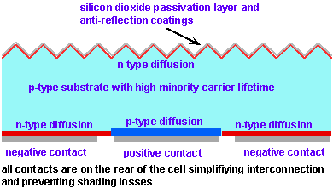
Solar cells
Interdigitated back contact
https://www.pveducation.org/pvcdrom/manufacturing-si-cells/rear-contact-solar-cells

Slide 47
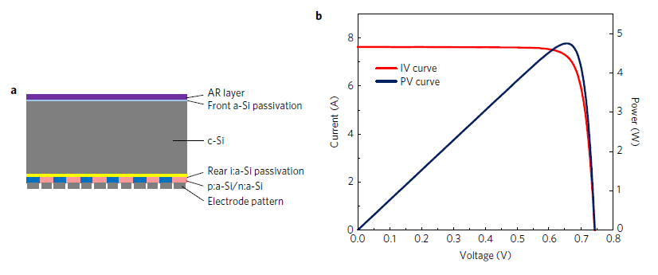
Solar cells
Paper: combining heterojunction and interdigitated back contact
26.3%
NATURE ENERGY 2, 17032 (2017) | DOI: 10.1038/nenergy.2017.32

Slide 48
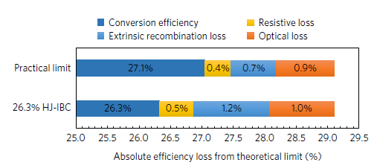
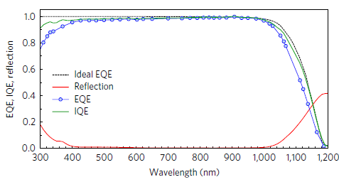
Solar cells
Paper: combining heterojunction and interdigitated back contact
NATURE ENERGY 2, 17032 (2017) | DOI: 10.1038/nenergy.2017.32

Slide 49
Photovoltaic materials
Schockley Queisser Limit: maximum conversion energy depending on the band gap of single junction solar cell
Photovoltaic materials: Present efficiencies and future challenges DOI: 10.1126/science.aad4424

Slide 50
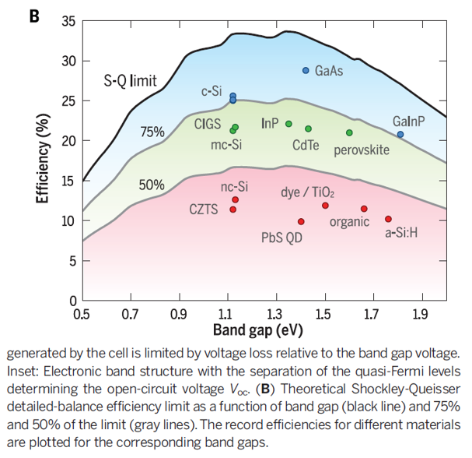
Photovoltaic materials
Schockley Queisser Limit: maximum conversion energy depending on the band gap of single junction solar cell
Maximum 33% can be converted into electric power
Photovoltaic materials: Present efficiencies and future challenges DOI: 10.1126/science.aad4424

Slide 51
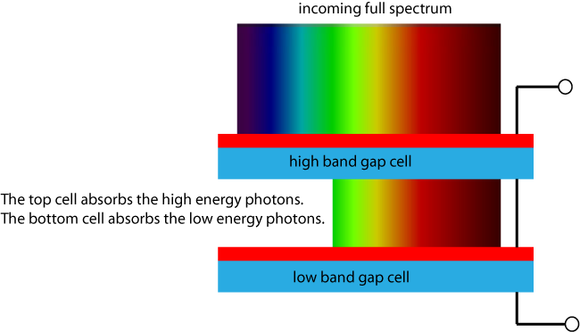
Solar cells
Increasing efficiency further:
Tandem solar cells: stacked solar cells with different band gaps
https://www.pveducation.org/pvcdrom/tandem-cells
https://www.pveducation.org/pvcdrom/tandem-cells

Slide 52
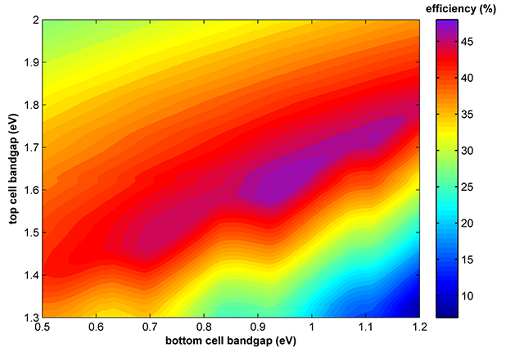
Solar cells
Increasing efficiency further:
Tandem solar cells: stacked solar cells with different band gaps
https://www.pveducation.org/pvcdrom/tandem-cells

Slide 53
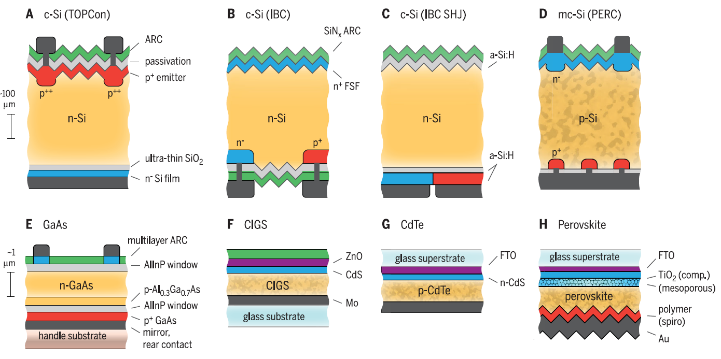
Solar cells
Tandem solar cells: Si + high band gap thin film solar cell
Photovoltaic materials: Present efficiencies and future challenges DOI: 10.1126/science.aad4424

Slide 54
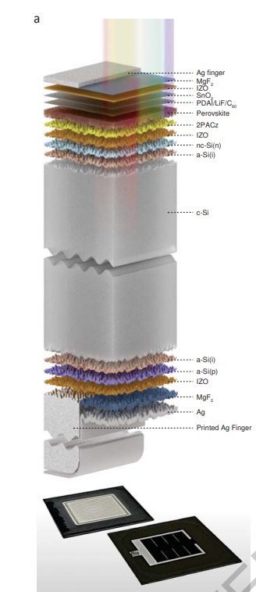


Solar cells
Record tandem cell 32.5%
Published: 28 September 2023
Enhanced optoelectronic coupling for perovskite-silicon tandem solar cells

Slide 55
Next lectures
Week 4: no lectures / no labo
Week 5: Thin film PV technology and light management
Week 5 & 6: Solar cell labo (Diepenbeek)
Papers in Toledo:
NATURE ENERGY 2, 17032 (2017) | DOI: 10.1038/nenergy.2017.32
High-efficiency crystalline silicon solar cells: status and perspectives DOI: 10.1039/c5ee03380b

